Slide 1
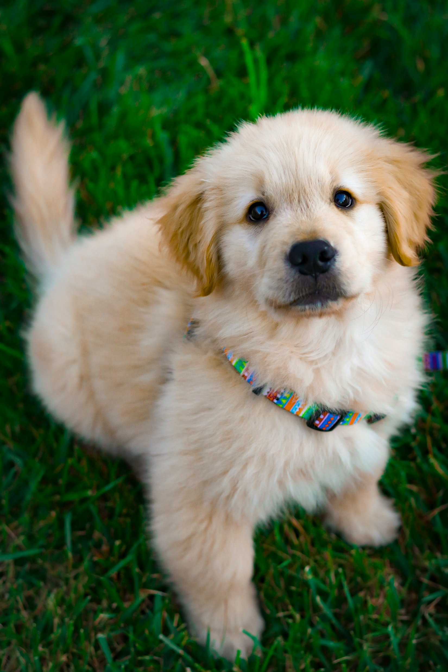
Enhancing Pet Adoption with LightGBM
A Data-Driven Approach to Saving Lives
Group #4
Daniel Sa
Christian Piantanida
Kaustubh Patil

Slide 2
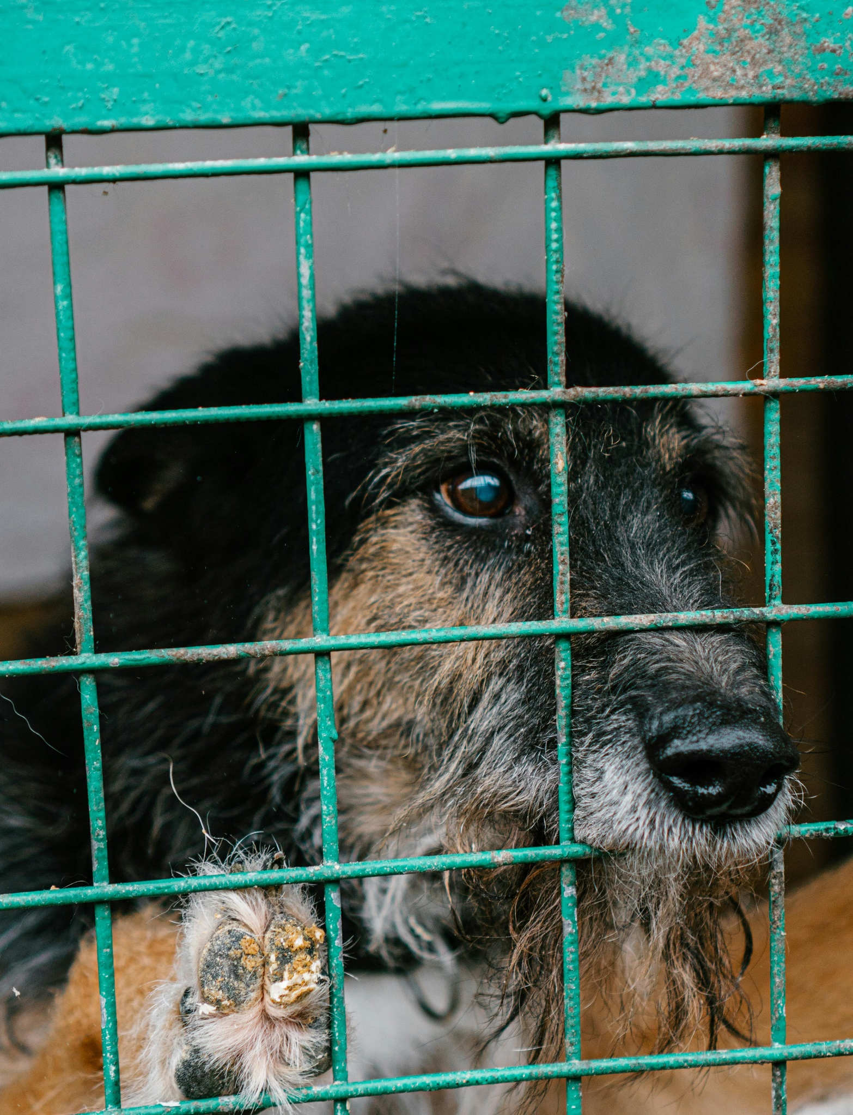
Executive Summary
The current data shows that 27% of pets are not adopted. Shelters in Malaysia need a way to not only predict which pets may not be adopted, but also understand why.
We have used a superior gradient boosting technique to build a model that can help us:
Prioritize weaker profiles
Identify ways to improve profiles
Unite doggos and kitties with loving families

Slide 3

The data
15000 Profiles
The Challenge
23 Predictors
Predict which pets will be adopted
Understand which features contribute to adoption
Make the solution scalable for Petfinder
Age
Breed
Color
Gender
Number of Photos
Description

Slide 4
KAHOOT!

Slide 5
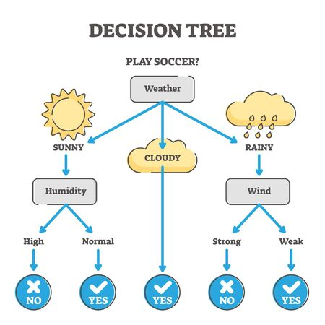
Tree Based Models
Many complex models that are widely used today are products of the base decision tree framework.
Begins with a root node and expands according to the max depth parameter and information gain.
Can be used to model non-linear relationships in data
Prone to overfitting if max depth parameter is set too high

Slide 6
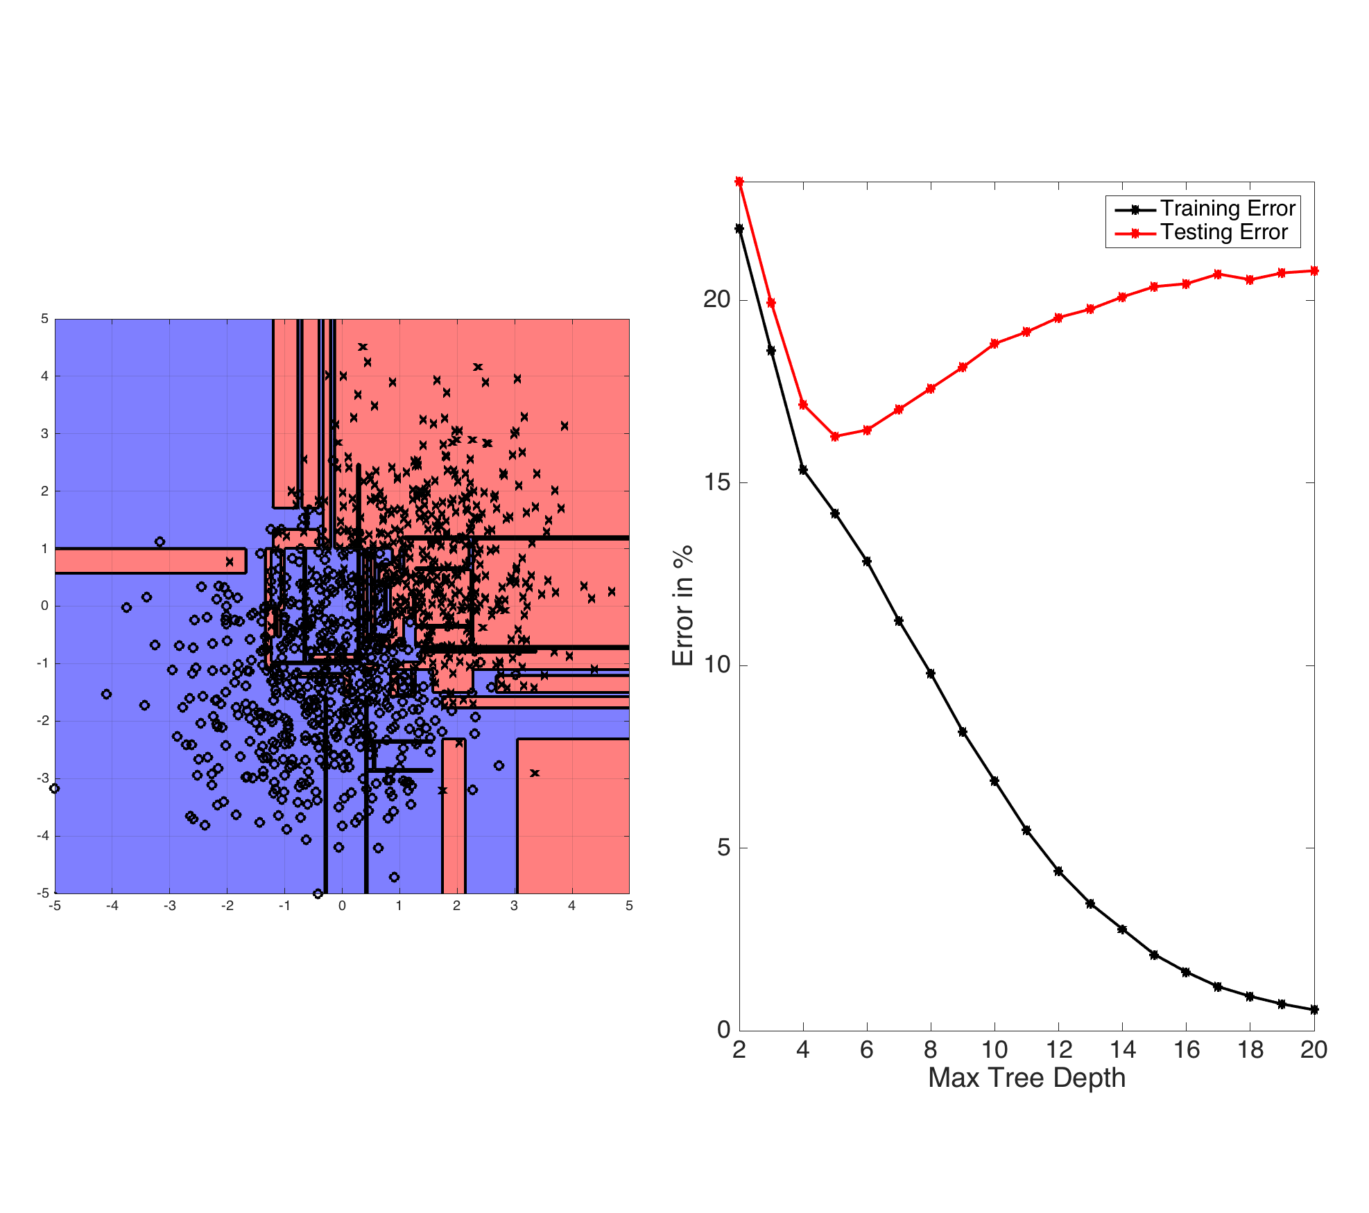
Decision Tree Overfitting

Slide 7
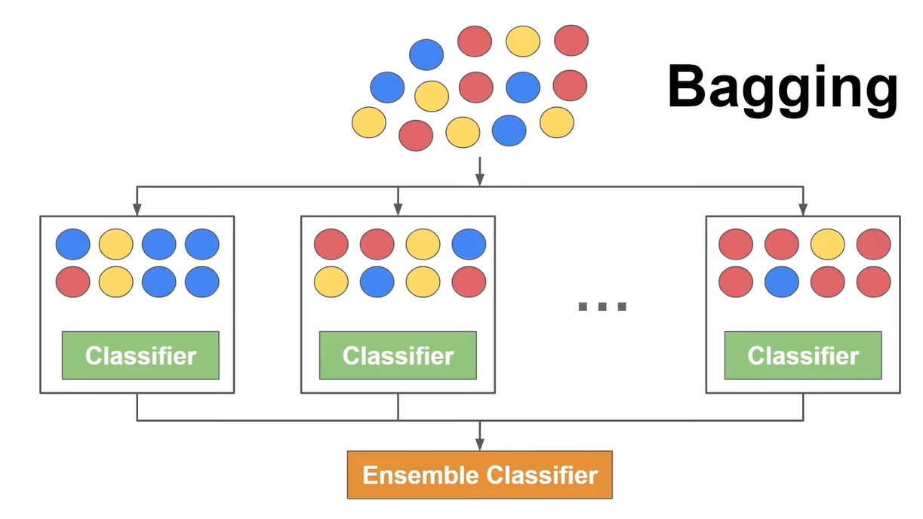
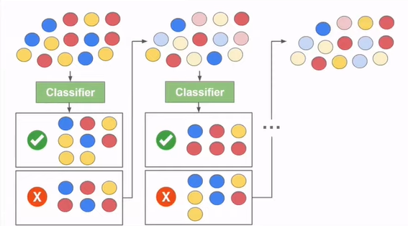
Tree Based Models - Bagging vs Boosting
Bagging
Bootstrap + Aggregating
Goals
In Bagging, the goal is to reduce the variance in model.
Boosting aims for increasing the prediction accuracy of the model.
Processing
Bagging has parallel processing.
Boosting has sequential processing.
Boosting
Notes:
https://www.youtube.com/watch?v=tjy0yL1rRRU&ab_channel=DataMListic ← Image and Education Credit

Slide 8


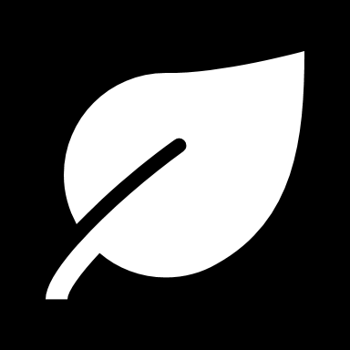
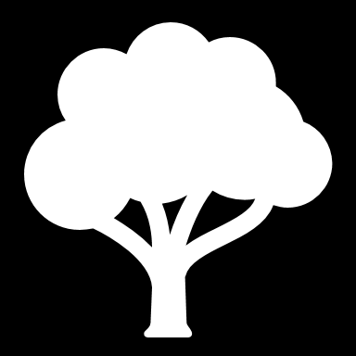
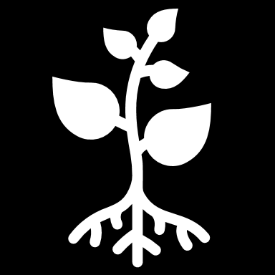
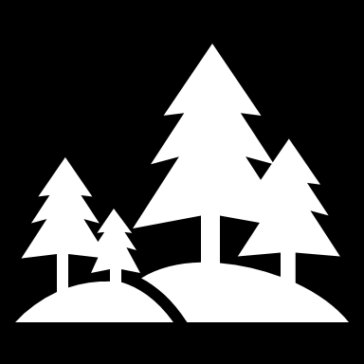
Leaf vs Level Wise Growth - DS
Leaf vs Level-Wise Growth
Traditional methods: Grow trees level-wise, splitting all leaves at the same level simultaneously.
LightGBM: Grows leaf-wise, prioritizing the leaf with the greatest potential improvement in the loss function.
This leads to faster training and often lower error trees. However, it can be more prone to overfitting on small datasets.

Slide 9
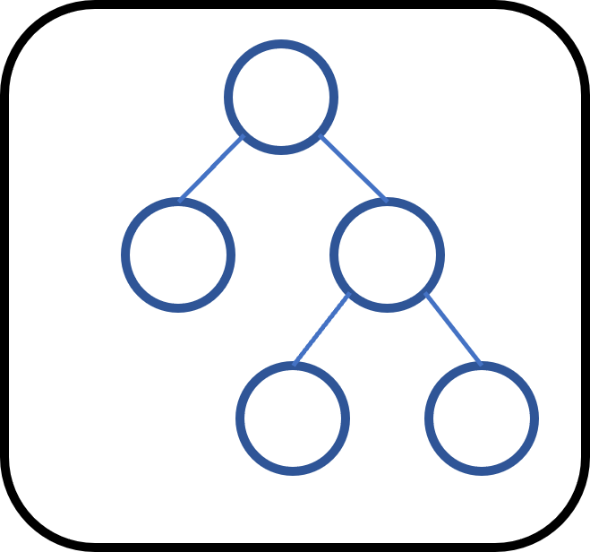
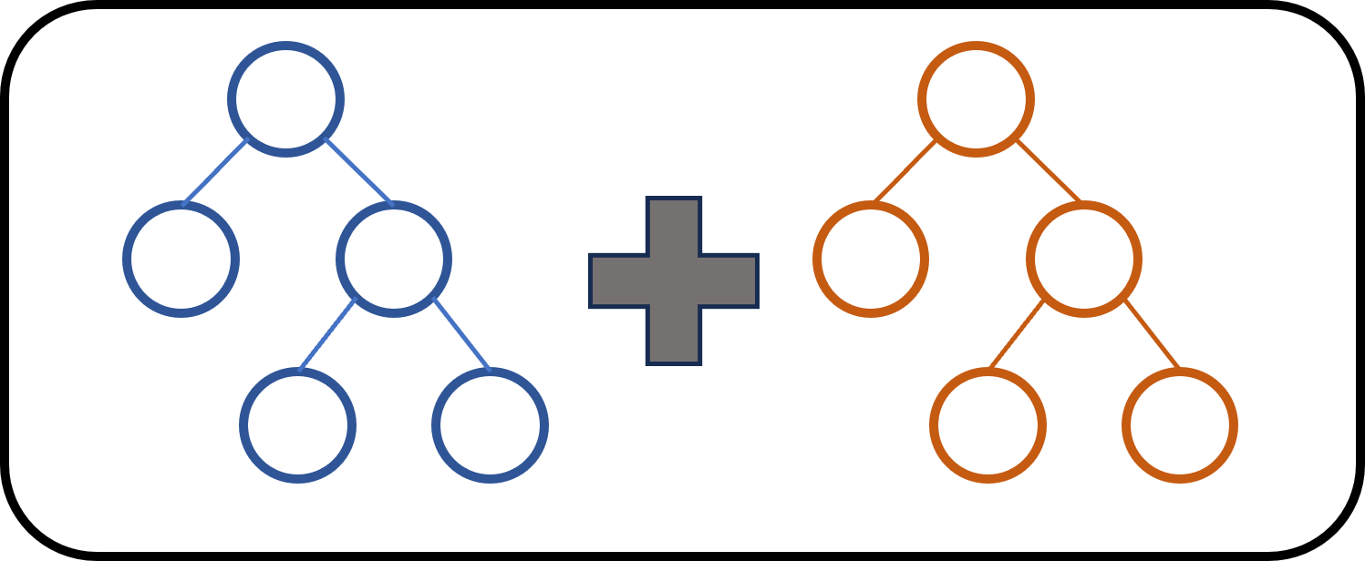
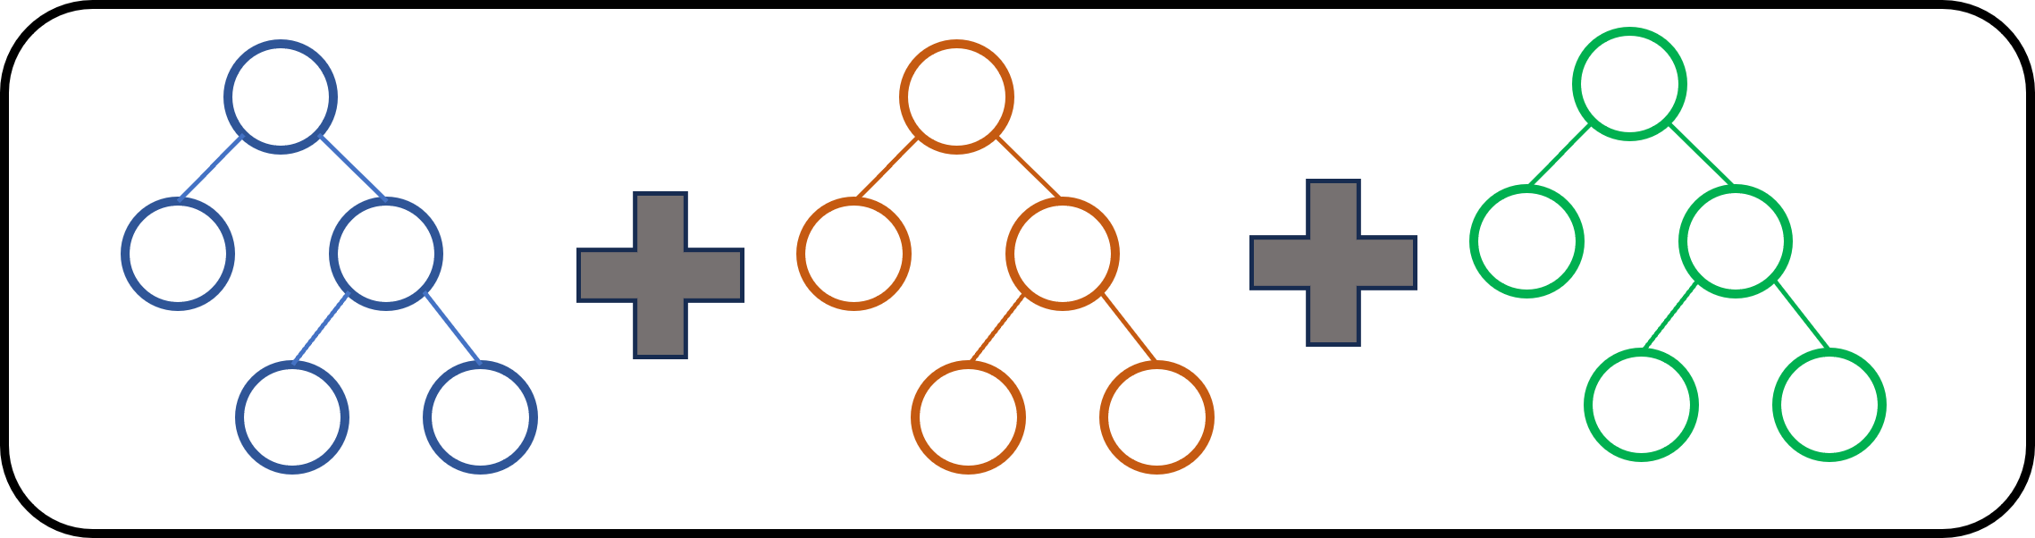
Gradient Boosting – What’s happening?
Step 1: Fits an initial model (usually a decision tree) to the data.
Add a tree
Step 2: A second model is built that focuses on accurately predicting the cases where the first model performs poorly
Ensemble Model
A combination of simple individual models that together create a more powerful new model.
Error
Add another tree
Step 3: ITERATE!
Keep adding trees!
Number of iterations

Slide 10
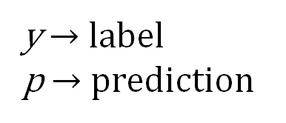
Gradient Boosting - Equations
With gradient boosting, we are optimizing the “ensemble” of models by minimizing the loss function.
The loss function is a representation of how right or wrong predictions are.
In the case of classification, this is the probability of the prediction and the binary outcome.
We are comparing the loss with each preceding collection of trees – with each ensemble.
$$Loss\left(y,p\right)=−\left\{\left[y∗log⁡(p)\right]+\left[(1−y)∗log⁡(1−p)\right]\right\}$$
y $→$ label
p $→$ prediction
Information Gain
For the positive class
Information Gain
for the negative class

Slide 11
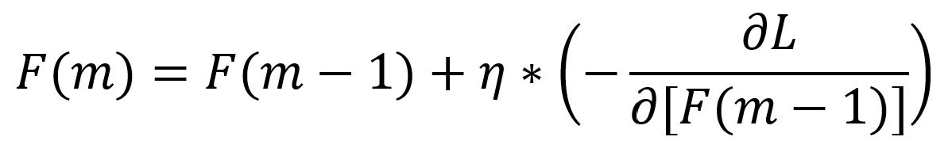
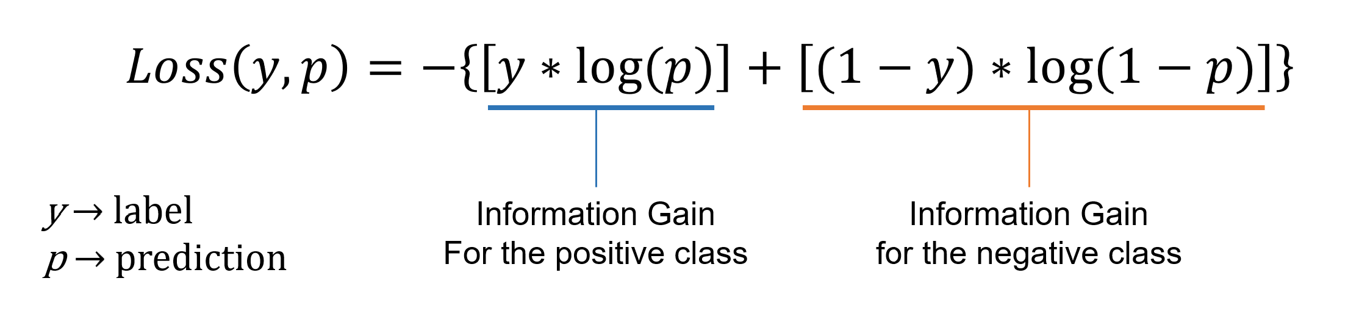
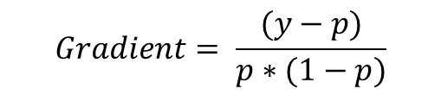
Gradient Boosting - Equations
We want to minimize this
Boosted ensemble
Previous ensemble
Gradient (derivative) of the loss function
The learning rate $η$ is a hyperparameter – a constant value that can be tuned to control the training process.
This loss is minimized over multiple iterations
$$Gradient= \frac{(y−p)}{p∗(1−p)}$$

Slide 12
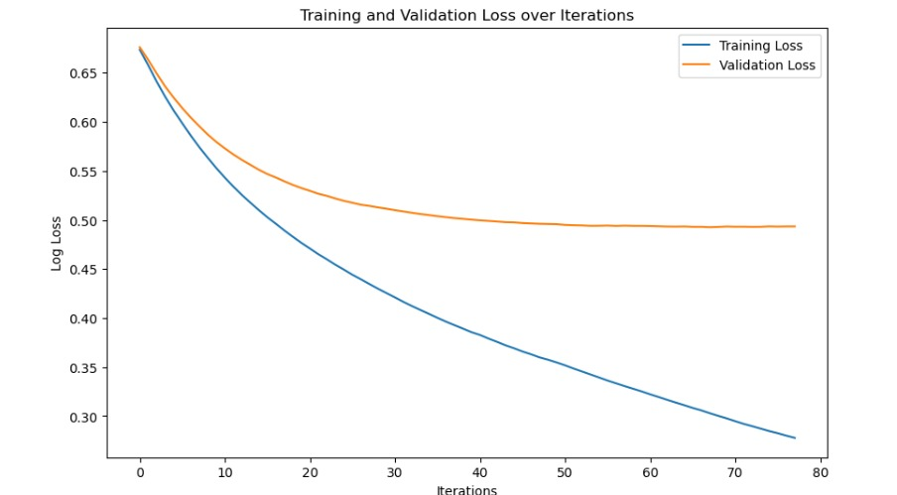
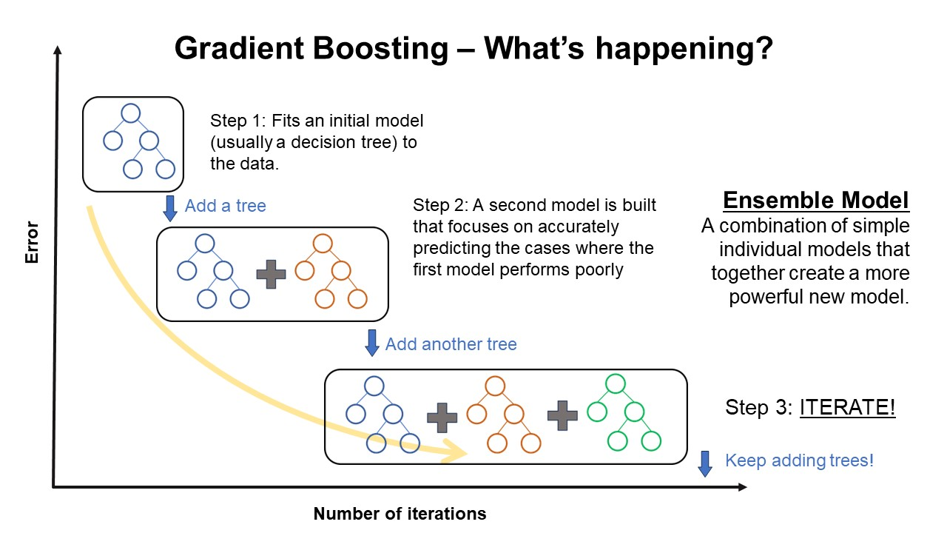
Goal: Reach a point where the loss function is minimum, after which adding more decision trees does not change or increase the loss of the model.

Slide 13
LightGBM
LightGBM is a gradient boosting framework that uses tree-based learning algorithms and is designed for speed and efficiency, particularly for large datasets.
Why is it special?
​Histogram-based splitting
Uses histograms to efficiently find the best split point for each feature based on binned data, rather than considering every single data point.
Gradient-based One-Side Sampling (GOSS)
​Reduces the number of data points considered when finding the best split for a tree node. This significantly improves training speed and memory usage.​
Exclusive Feature Bundling (EFB)
Groups features with similar values beforehand, reducing the number of features scanned during the splitting process. This further boosts efficiency.
As Petfinder.my aims to scale their operations globally, the chosen model needs to be scalable. LightGBM scales well with the number of data points, making it future-proof for Petfinder.my as their dataset grows.

Slide 14
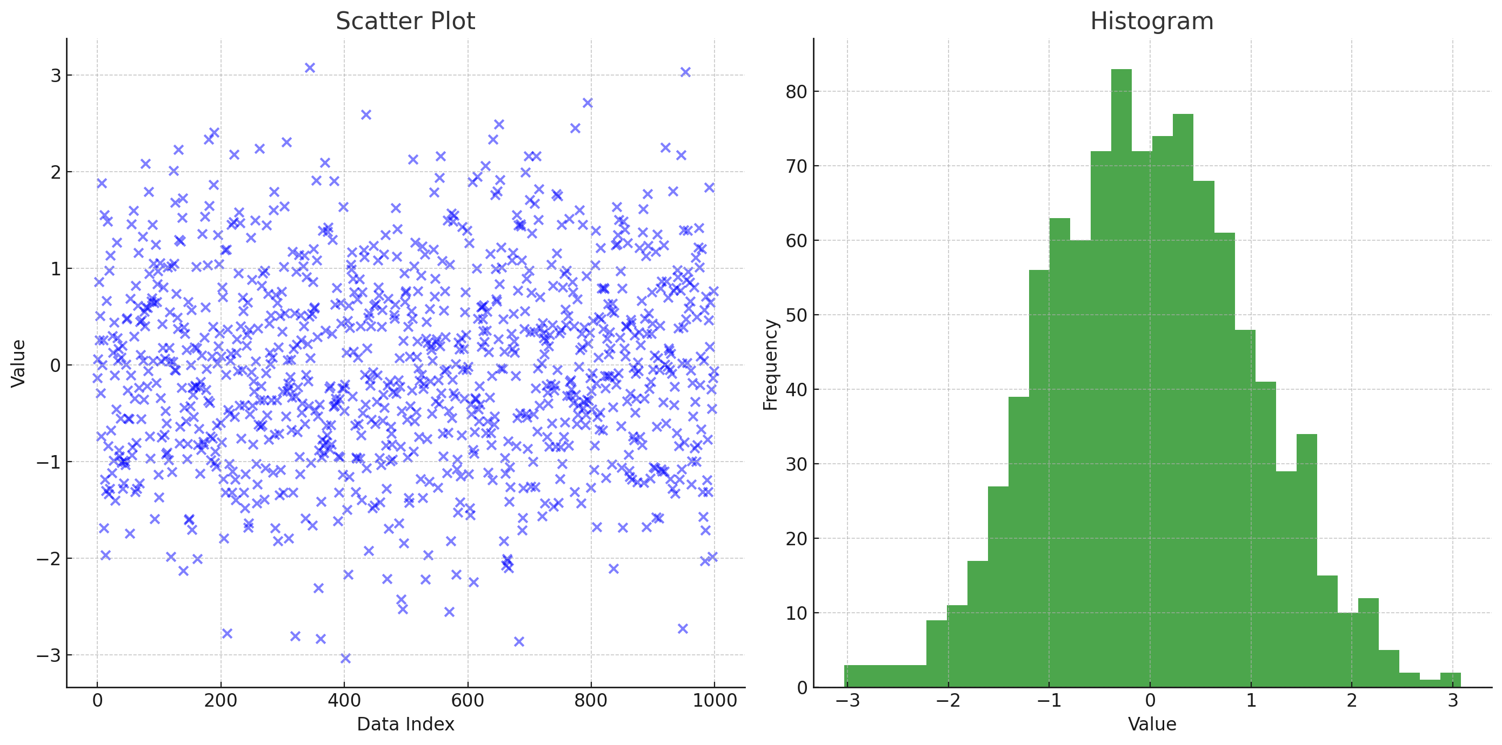
Histogram-based splitting
Aggregate
continuous features into discrete bins.
Notes:
LightGBM decides the size of bins to use in histogram-based splitting during the pre-processing stage before training begins. The maximum number of bins is a parameter that can be set by the user (max_bin), and its default value is 255. This parameter is a trade-off between model complexity and overfitting:
A larger max_bin value increases the model's complexity since it allows the algorithm to make finer distinctions between feature values.
A smaller max_bin value can act as a form of regularization, potentially reducing overfitting but possibly also leading to a loss of information if too many values are binned together.

Slide 15

Feature Bundling
Bundled Features
Feature 1
Feature 2
1
0
1
2
0
2
0
5
5
Combines sparse features in order of descending mutual exclusiveness​
0
1
1
3
0
3
Notes:
LightGBM decides the size of bins to use in histogram-based splitting during the pre-processing stage before training begins. The maximum number of bins is a parameter that can be set by the user (max_bin), and its default value is 255. This parameter is a trade-off between model complexity and overfitting:
A larger max_bin value increases the model's complexity since it allows the algorithm to make finer distinctions between feature values.
A smaller max_bin value can act as a form of regularization, potentially reducing overfitting but possibly also leading to a loss of information if too many values are binned together.

Slide 16

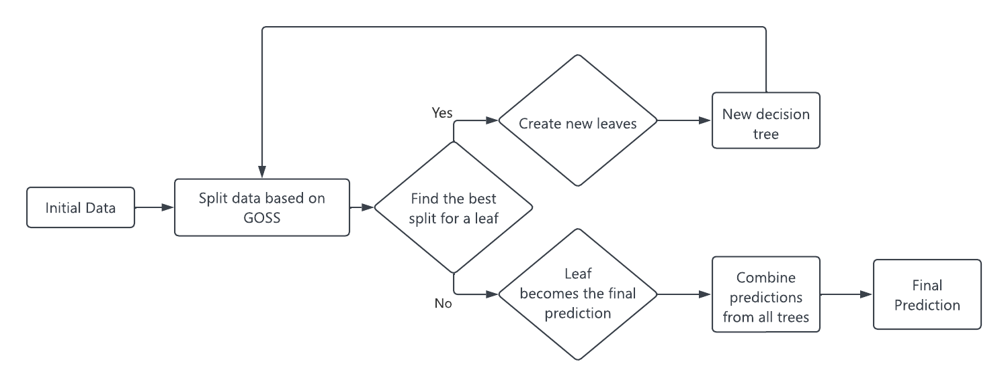
LightGBM Architecture
Split point that leads to the largest reduction in loss
Data points with higher gradients (which contribute more to the loss)

Slide 17

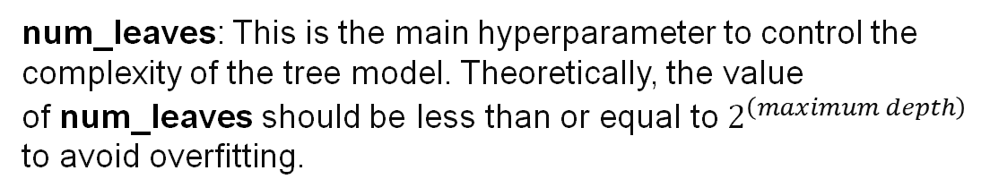
Hyperparameters
num_iterations: Number of boosting iterations (weak learners) included in the model.
num_leaves: This is the main hyperparameter to control the complexity of the tree model. Theoretically, the value of num_leaves should be less than or equal to $2^{\left(maximum depth\right)}$ to avoid overfitting.
max_depth: It specifies the maximum depth or level up to which tree can grow.
max_bin: The maximum number of bins that feature values will be bucketed in.
min_gain_to_split: Minimum gain needed for another partition on a leaf node.
boosting_type: Determines the type of algorithm to run. Common options are ‘gbdt’ for Gradient Boosting Decision Tree and ‘dart’ for Dropouts meet Multiple Additive Regression Trees.
feature_fraction: This is the fraction of features to be used for each iteration of training, randomly selected. Using a subset of features prevents overfitting and can lead to faster training.

Slide 18

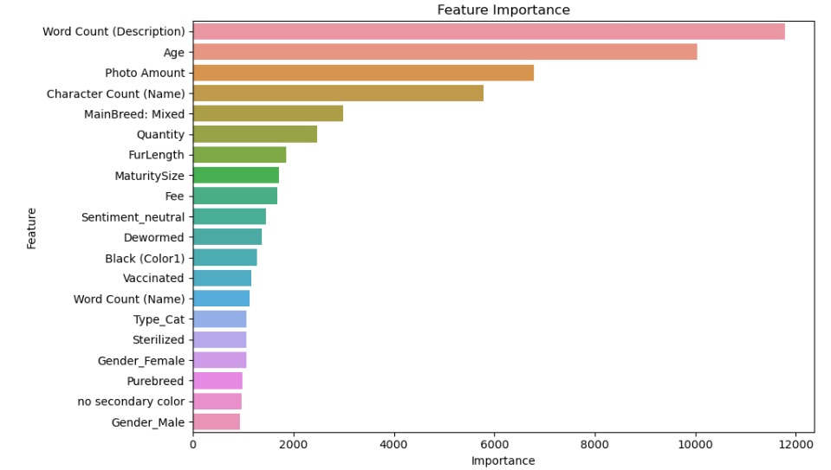
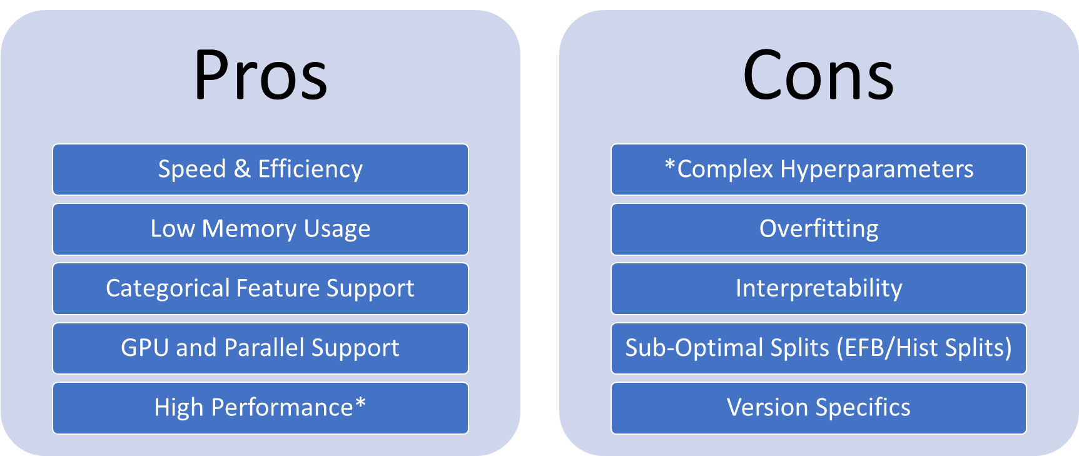

Model Accuracy: 76% ​
Notes:
Another great feature of the models used is the feature importance.
While this isn’t as interpretable as a linear regression equation, it still gives clients an idea of how important certain facts of are relative to each other.

Slide 19

Thanks! + Q&A

